Slide 1
Topic
Some Examples of Neural Networks (Contd..)

Slide 2
Recurrent Network of a Single Layer

Slide 3
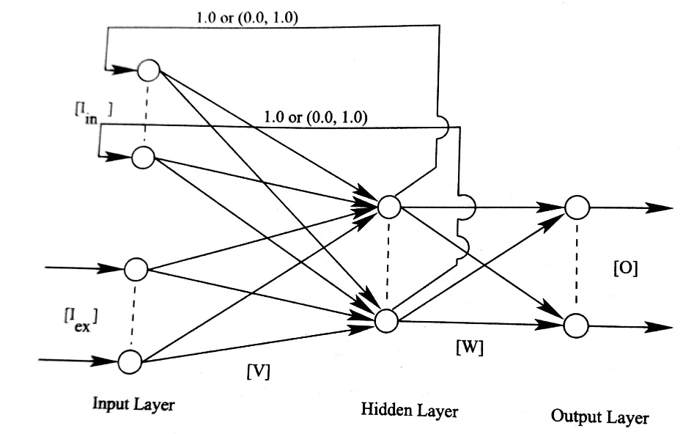
Recurrent Neural Network (RNNs)
A recurrent neural network has both feed-forward and feed-back connections
Information can be processed from input layer to output layer and vice-versa
It forms a cycle or loop
It may be preferred to MLFFNN for modeling a highly dynamic process
Elman Network
Elman Network

Slide 4
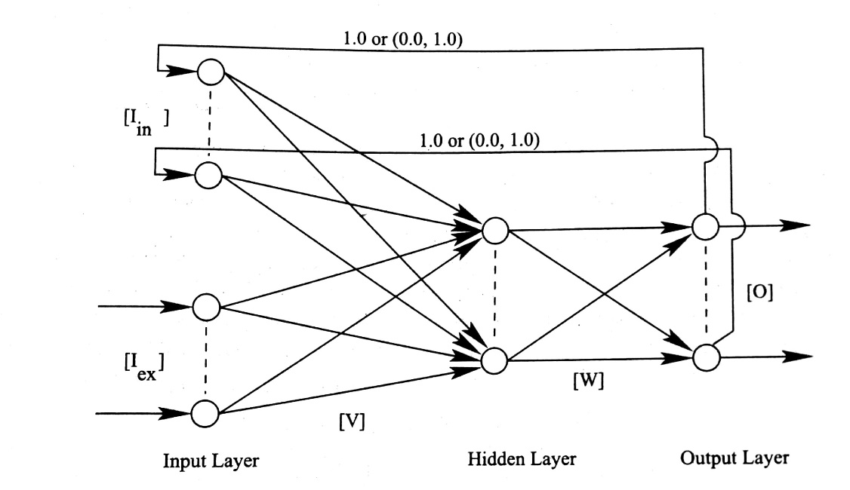
Jordan Network

Slide 5
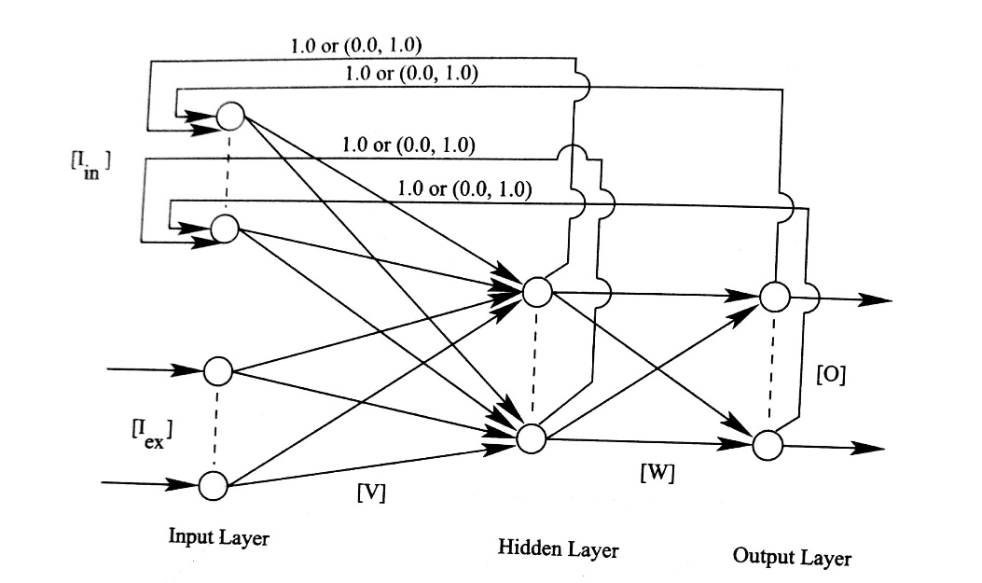
Combined Elman and Jordan Network

Slide 6
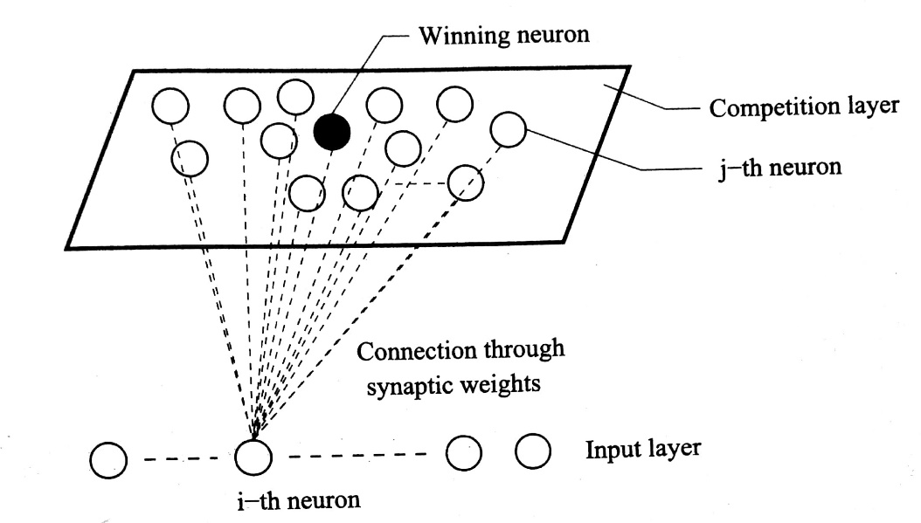
Self-Organizing Map (SOM)/ Kohonen Network
Proposed by T. Kohonen before 1995
It can be used as visualization technique or dimensionality reduction technique (topology preserving tool)
It can be used as a clustering algorithm also
It woks based on unsupervised and competitive learning
Self-Organizing Map
Self-Organizing Map

Slide 7
Non-linear generalization of principal component analysis
Consists of two layers: Input layer and competition layer
On competition layer, there are three basic operations, namely competition, cooperation and updating

Slide 8
Self-Organizing Map (SOM)/ Kohonen Network (Cont.)
Self-Organizing Map

Slide 9
Competition
Let us assume that there are N points (neurons) in the input layer and each point has m dimension
X_{i} = [x_{i1}, x_{i2},.. . . . , x_{im}]^{T},
where i = 1, 2, . . . . ., N
Let the synaptic weight vector between input neuron i and neuron j lying in the competition layer is denoted by
where j=1, 2, . . . . , N

Slide 10
Let n: neuron lying in the competition layer that has the best match with the input vector X_{i} Winning neuron
Euclidean distance between n and X_{i} can be expressed as follows:
n(X_{i}) = Minimum of
where j = 1, 2, . . . ., N

Slide 11
Cooperation
Surrounding a winning neuron, a neighborhood of excited neurons is defined for cooperation in order to update their synaptic weights
where t = 0 , 1, 2, . . .
: Lateral distance between the winning neuron n and excited neuron j
σ_{t} : Standard deviation at t-th iteration
σ_{t} = σ_{o} exp(-t/τ),
σ_{o}: Initial value of standard deviation
τ: Predefined number of maximum iterations

Slide 12
Updating
Synaptic weights of the winning neuron and excited neurons are updated as follows:
η(t): learning rate (0.0, 1.0)

Slide 13
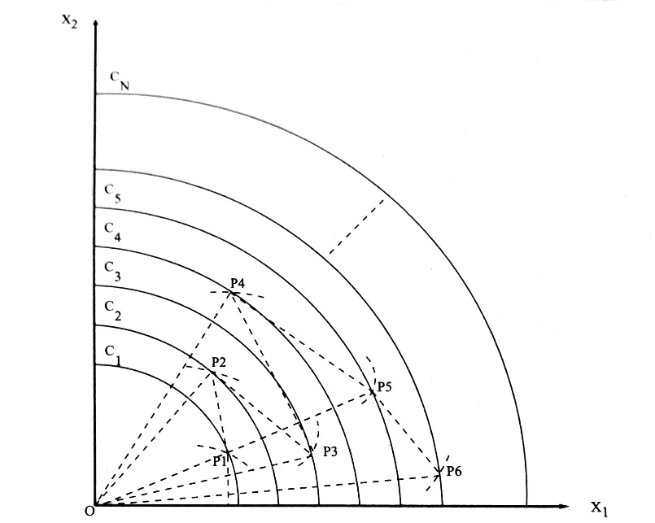
Final Mapping

Slide 14
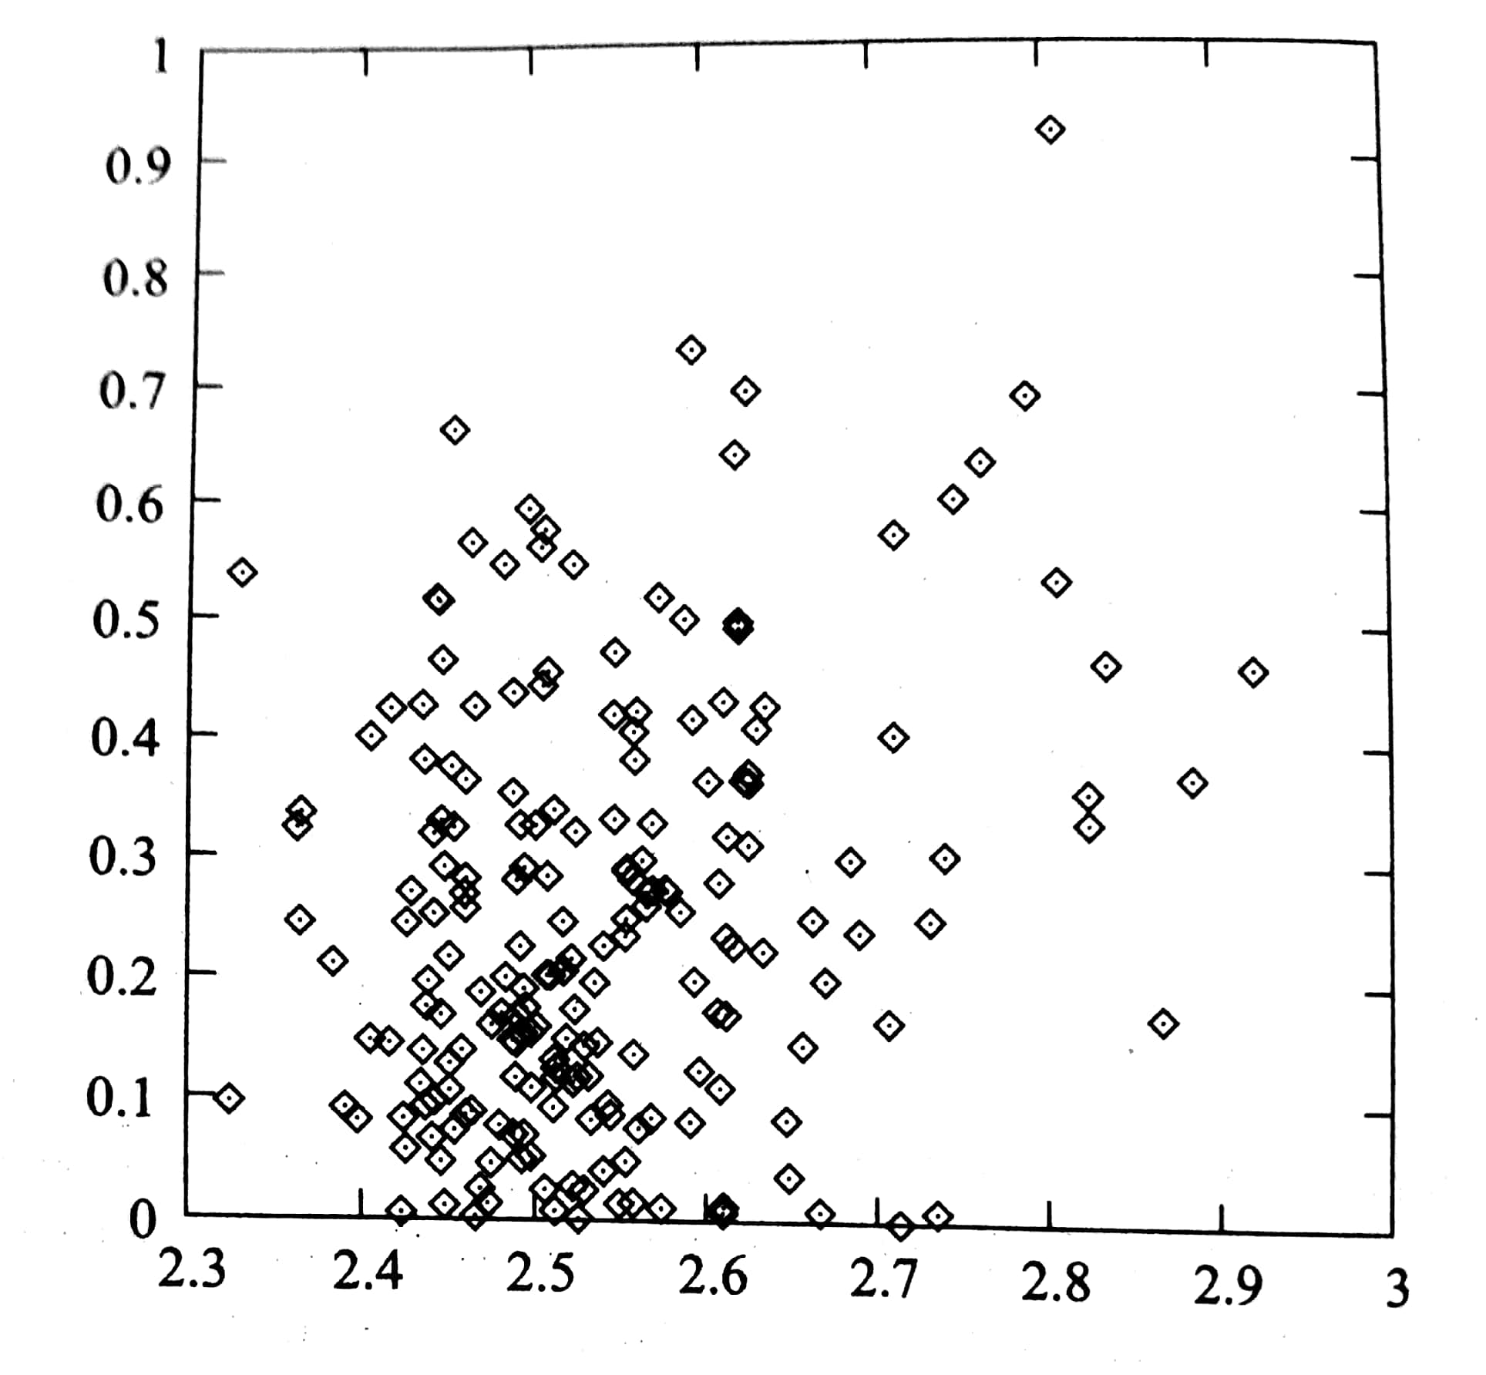
Simulation Results
Schaffer’s first test function

